Slide 1
Final presentation
Group 1: Volvo Co-Pilot eco-driving

Slide 2
Introduction to Client & Project
Volvo Construction Equipment & Volvo Co-Pilot

Slide 3

Client
Volvo Construction Equipment - Volvo CE - is a major international company that develops, manufactures and markets equipment for construction and related industries.
Volvo Construction equipment won the prestigious innovation award in June 2016 for most innovative HMI (human–machine interface) feature for Co Pilot

Slide 4
The project results

Slide 5
Requirements
Objectives:
- Implement an Android application for Volvo’s Co Pilot hardware
- Receive parameters such as speed, fuel consumption, distance, etc.
- Create a score from the input parameters
- Present the data to the driver in an intuitive manner
- Upload score to the web portal
How much of the requirements are fulfilled?
- We implemented complete desired and specified functionality.
Prioritizing features based on importance extracted from the requirements specification.

Slide 6
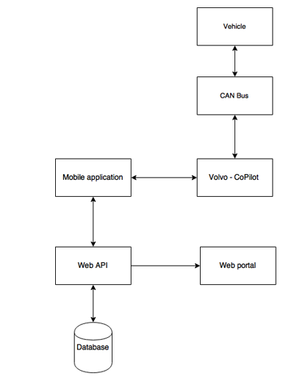
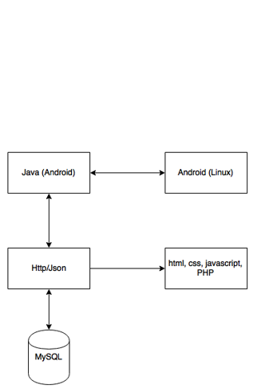
High-level design decisions, program structure and used technology

Slide 7
Ensuring important qualities (e.g. security, real-time behavior)
Performed testing on different test levels to establish confidence in developed system and build high quality software that is as much as possible resistant to security breaches.
Performed live testing on simulators in order to test real-time behavior and establish confidence at this part.
Acceptance testing
Acceptance testing was carried out on in the Volvo simulation labs at Mälardalen University

Slide 8
Result demonstration

Slide 9

Android application
Choose vehicle
Enter alias
Select amount of time
Play the game
Compete

Slide 10
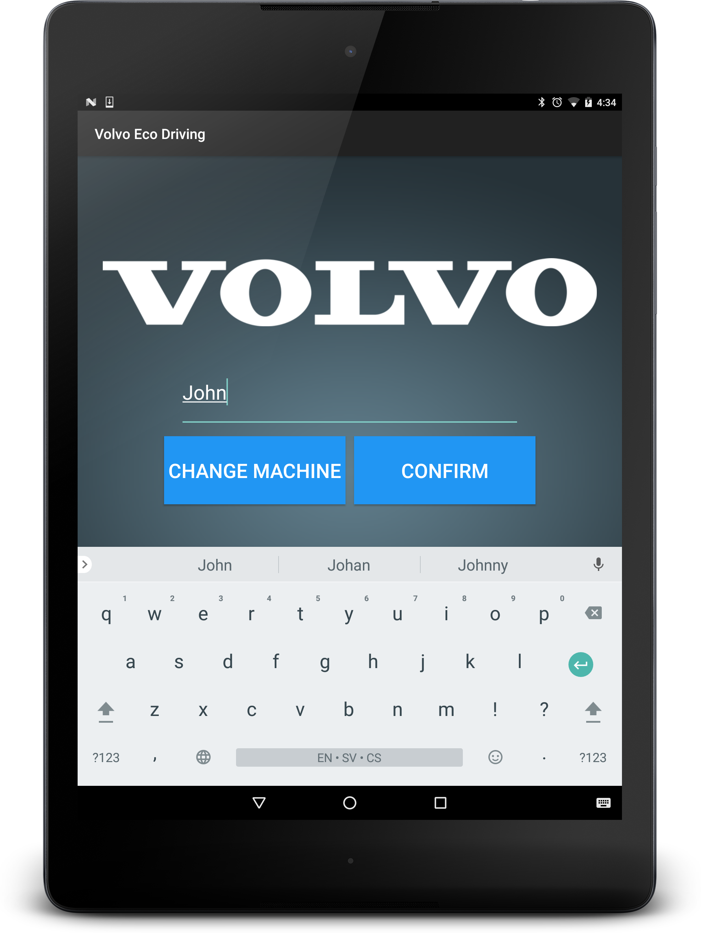
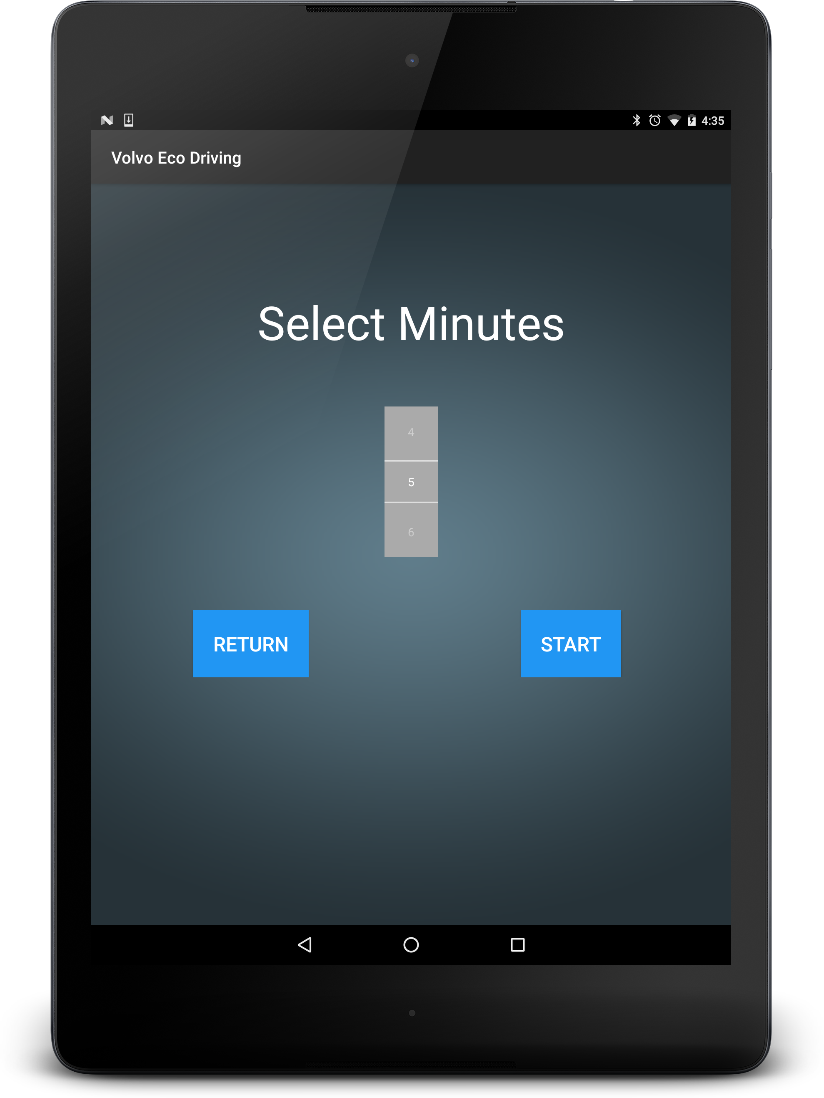

Slide 11
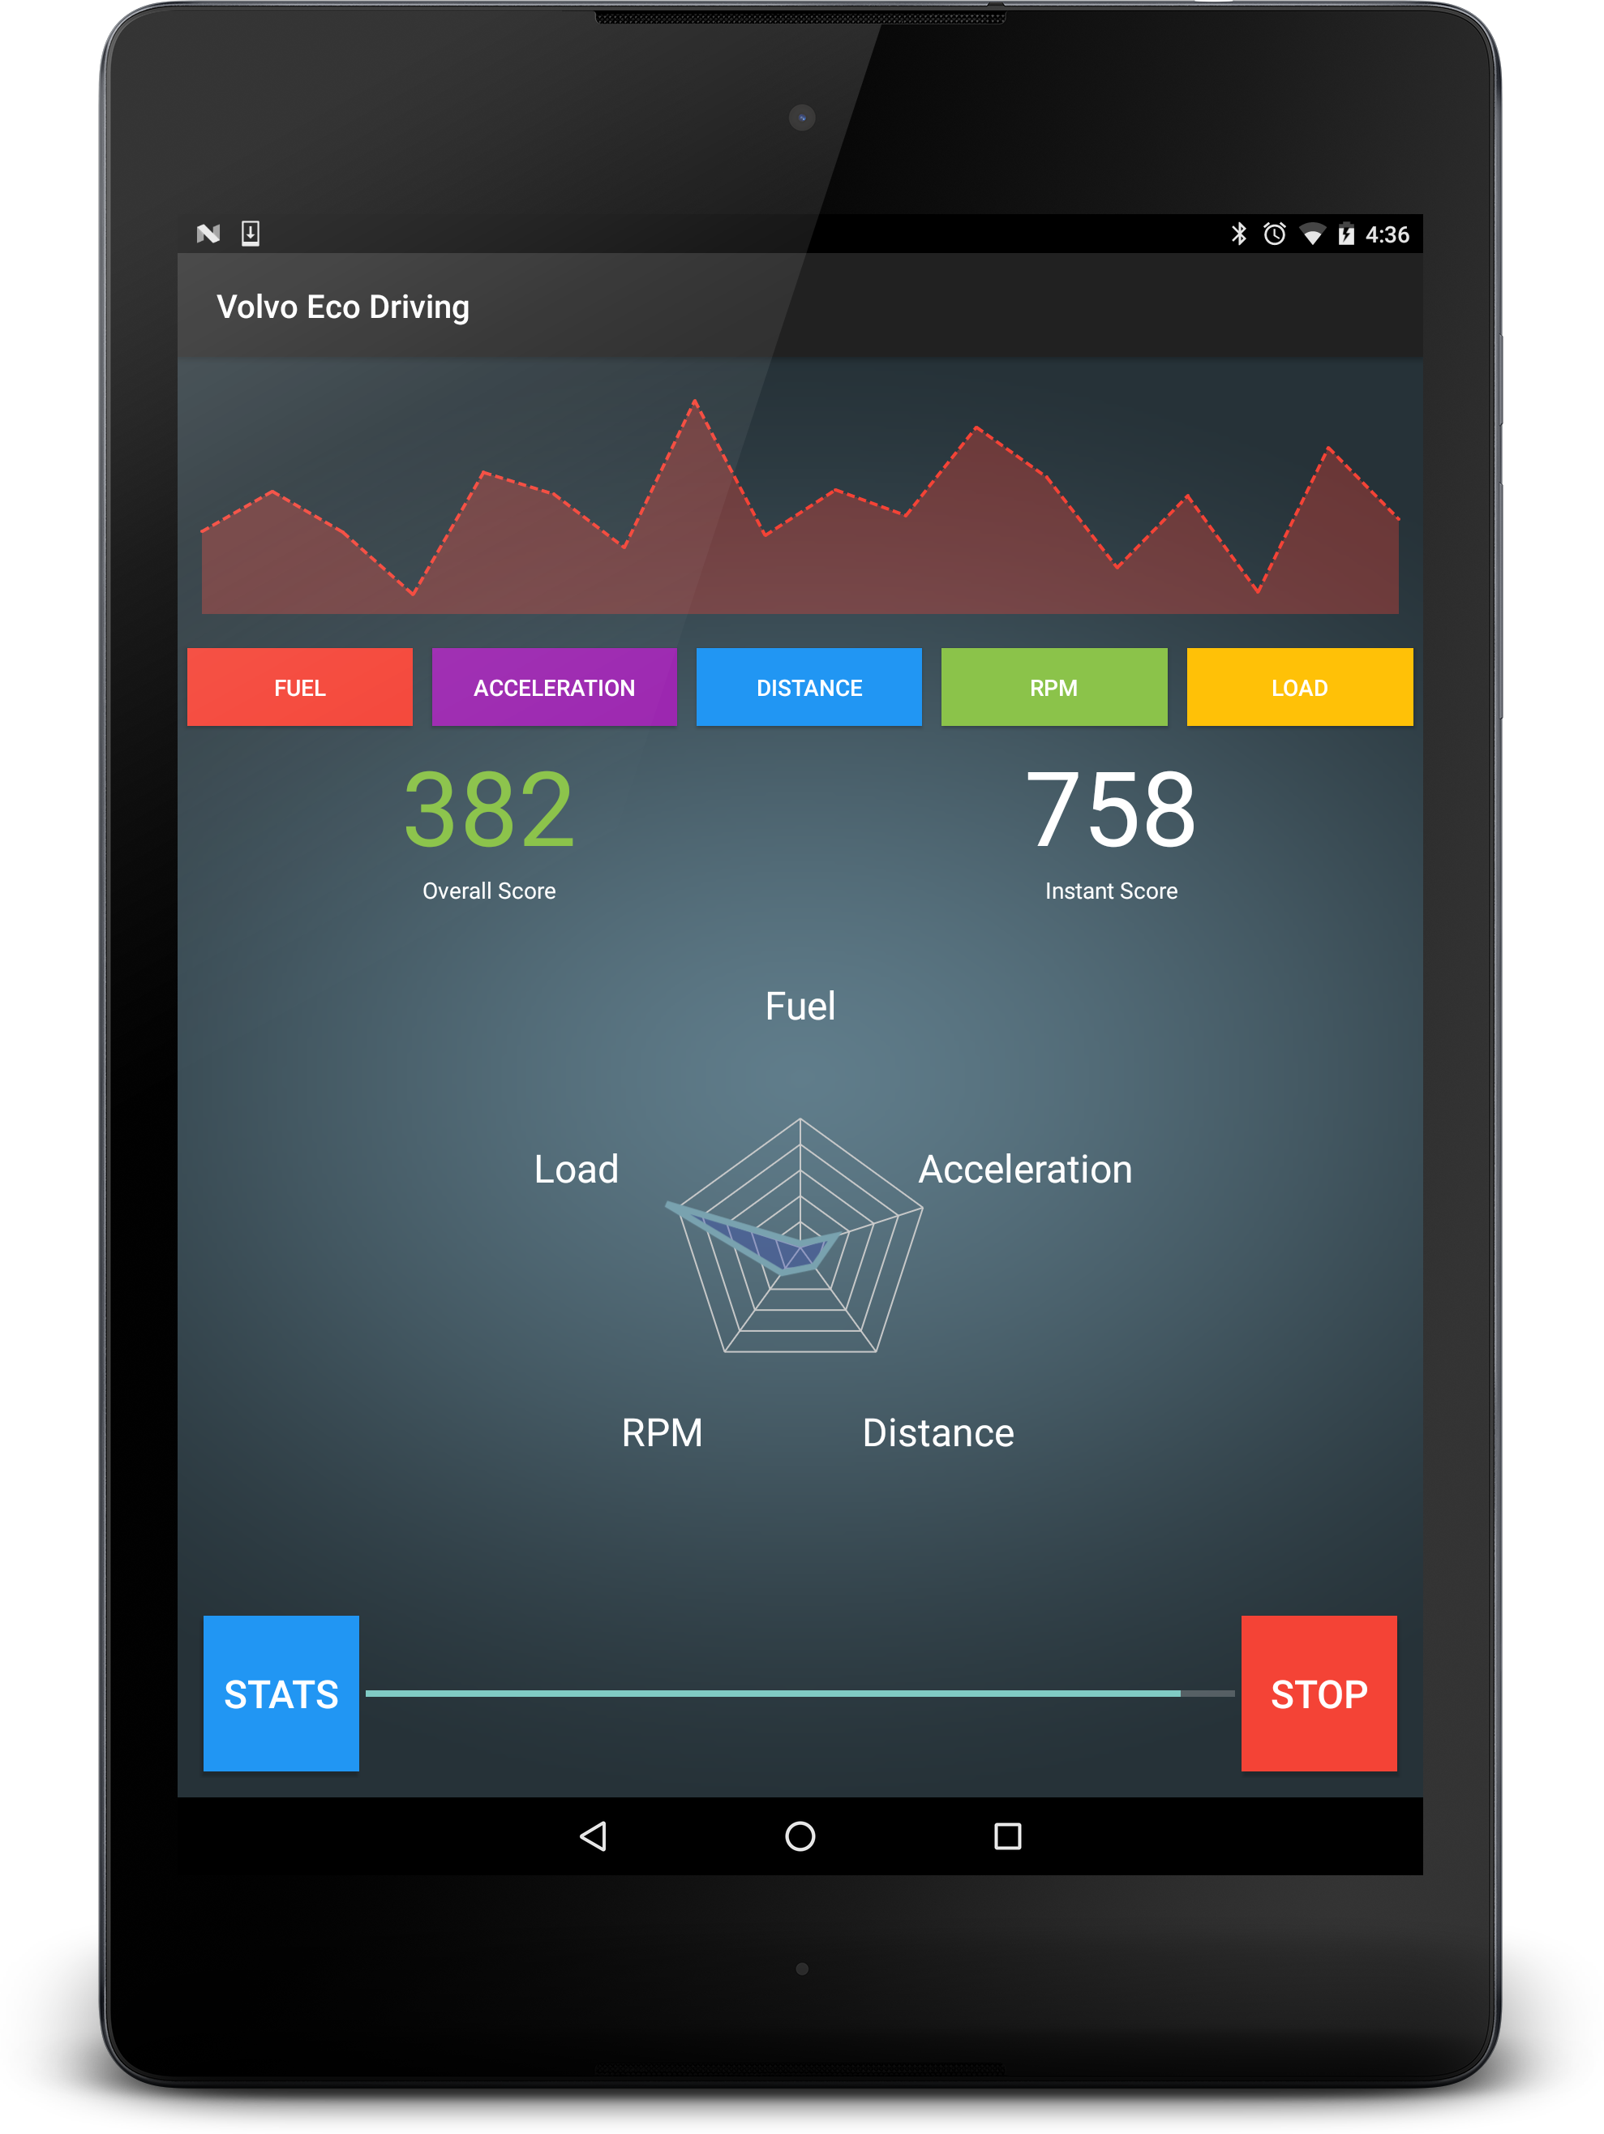
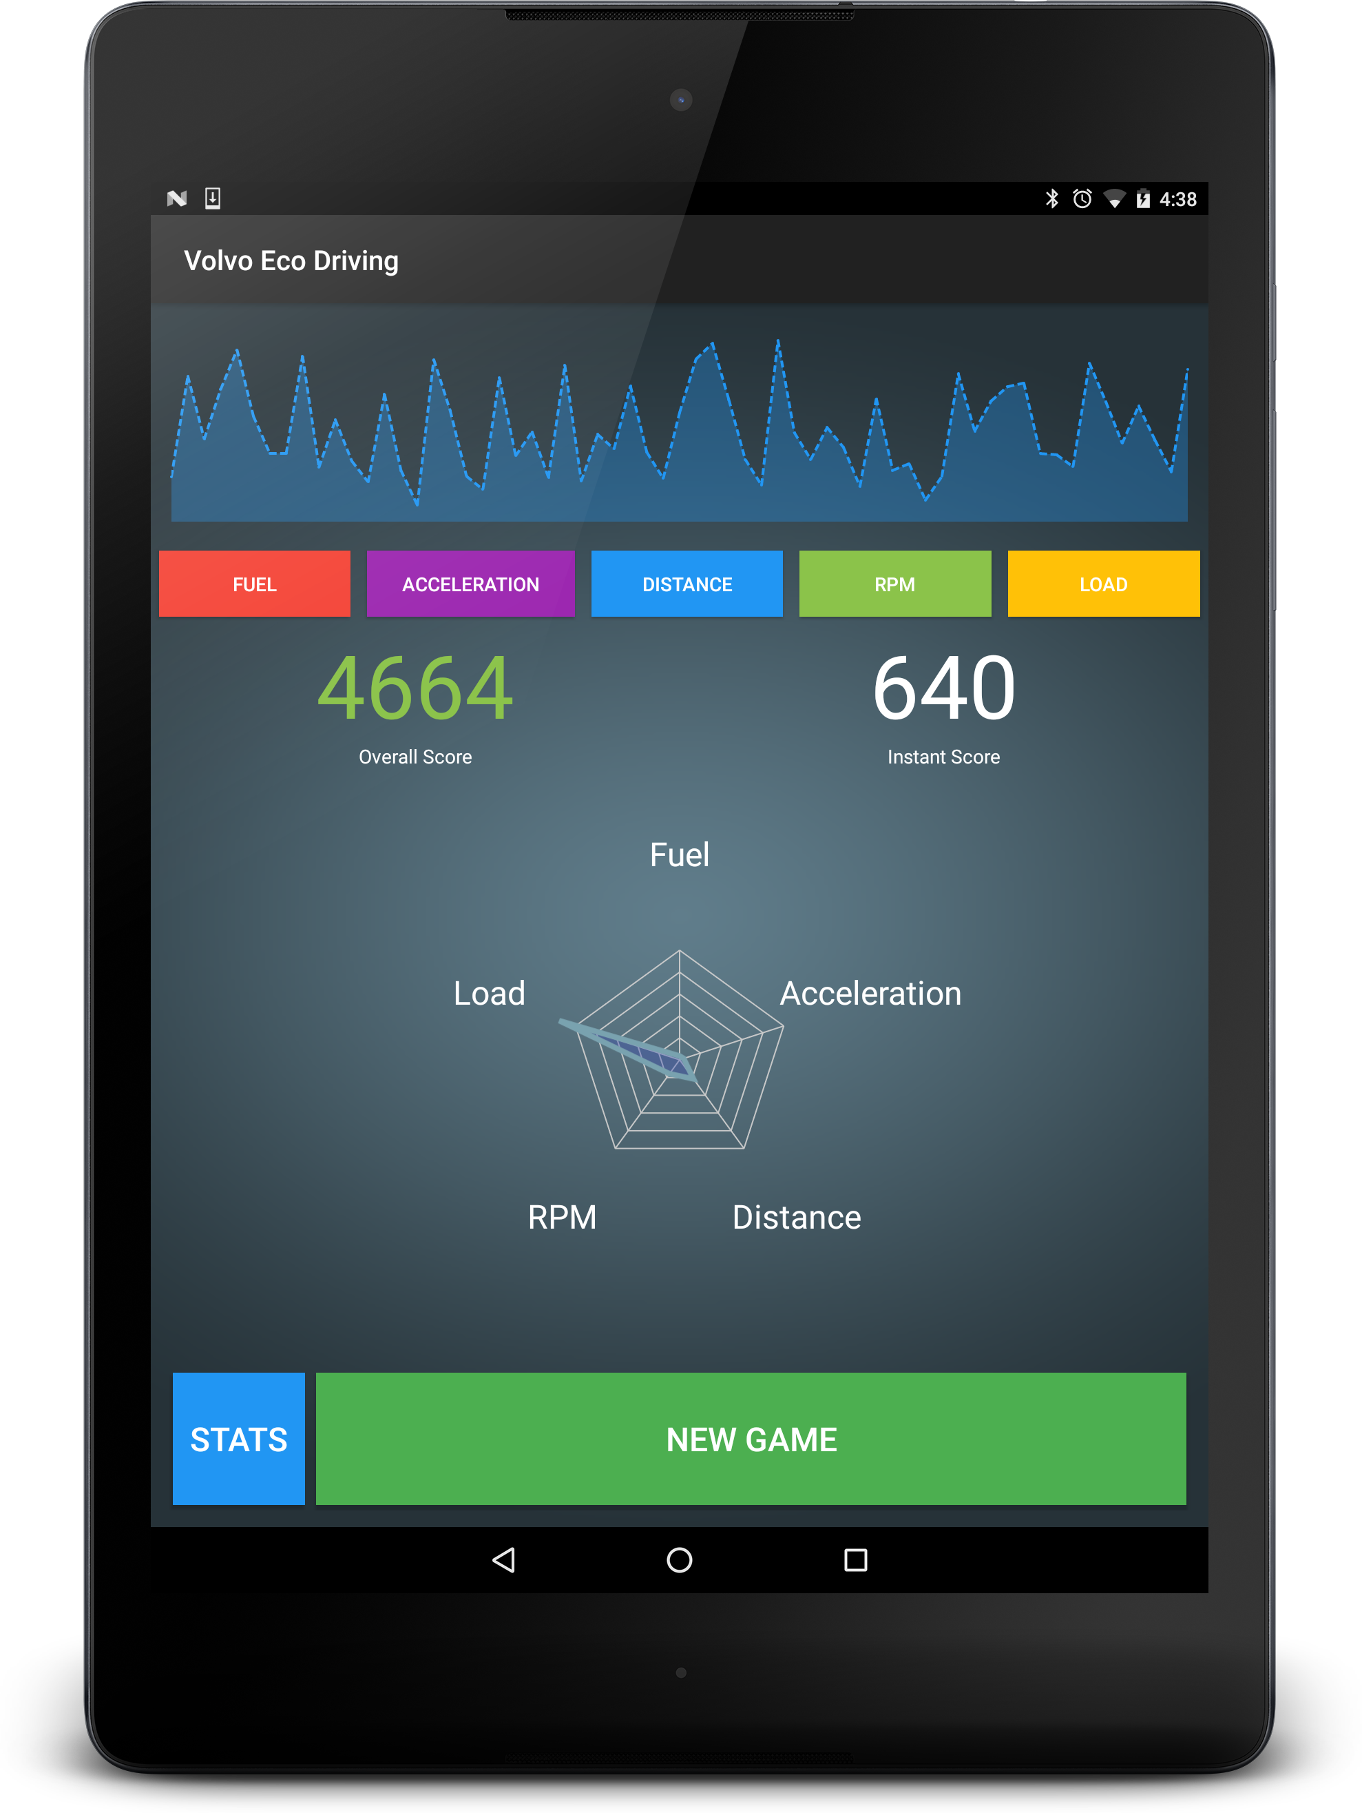

Slide 12
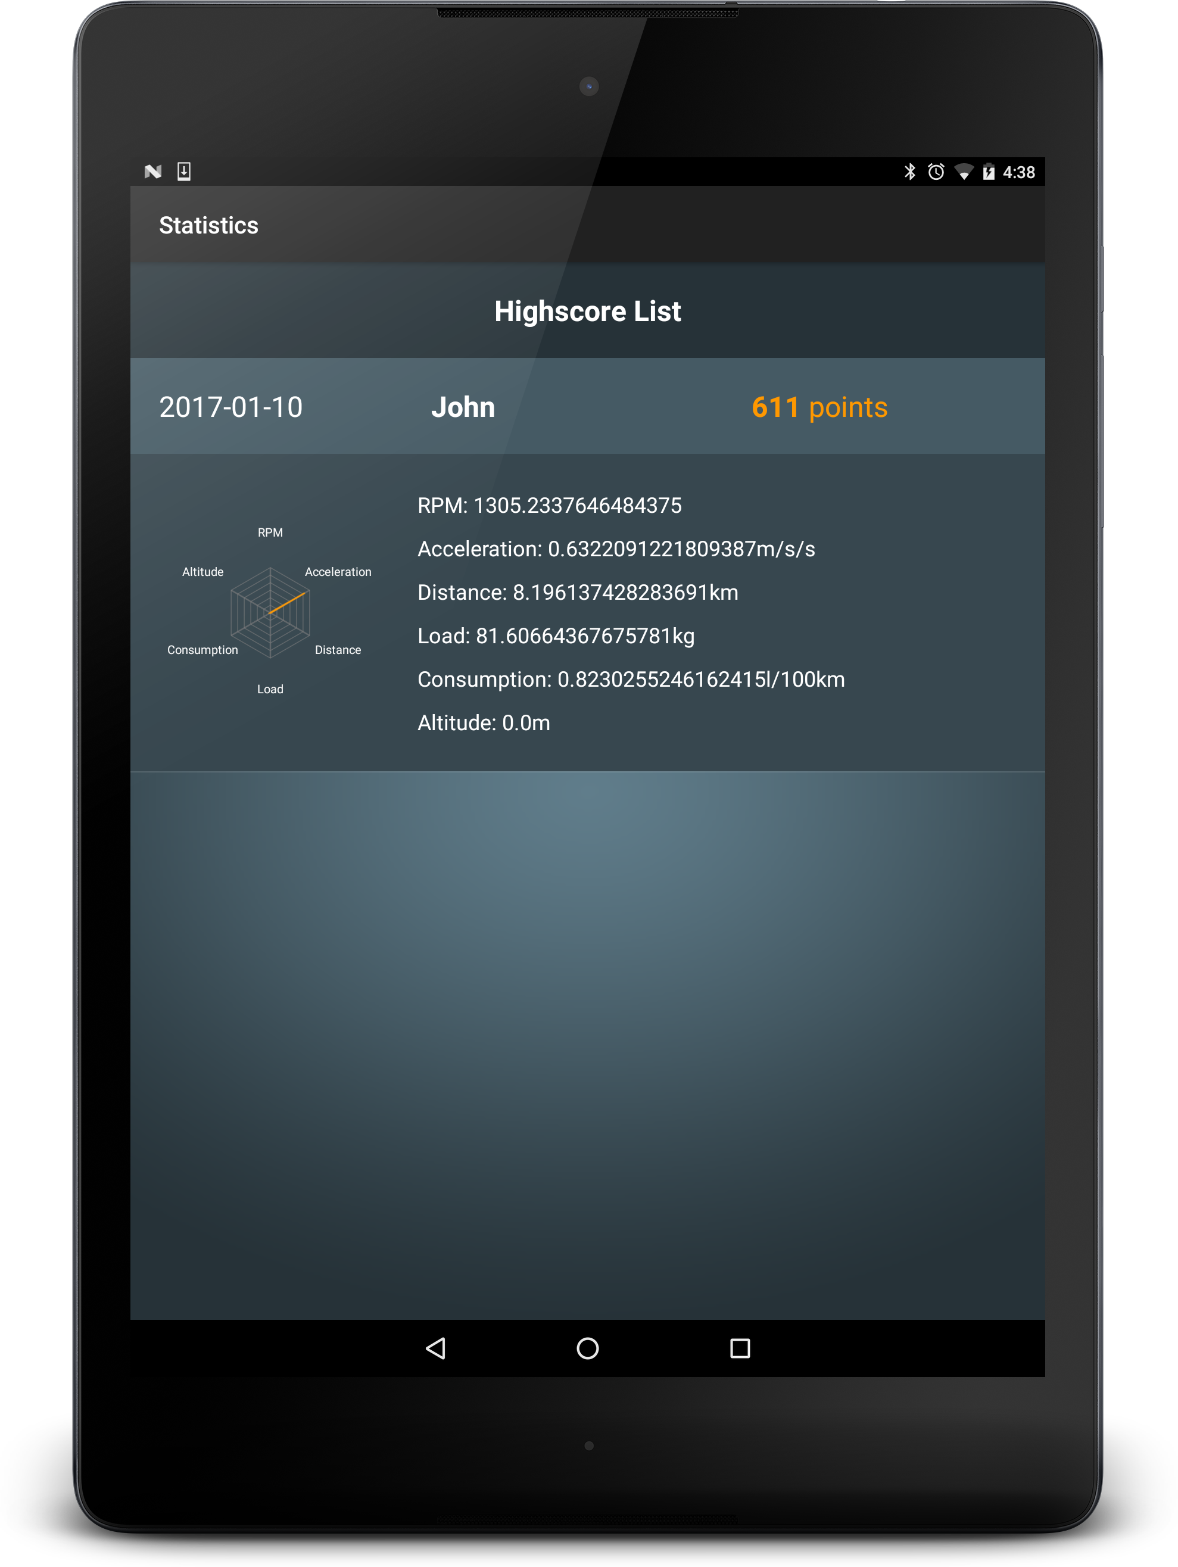
Android application
Upload score to the web application

Slide 13
Web application
http://autoelektronikame.ipage.com/volvo/

Slide 14
Demo
https://youtu.be/vbOyVtrjIP0

Slide 15
The project work

Slide 16
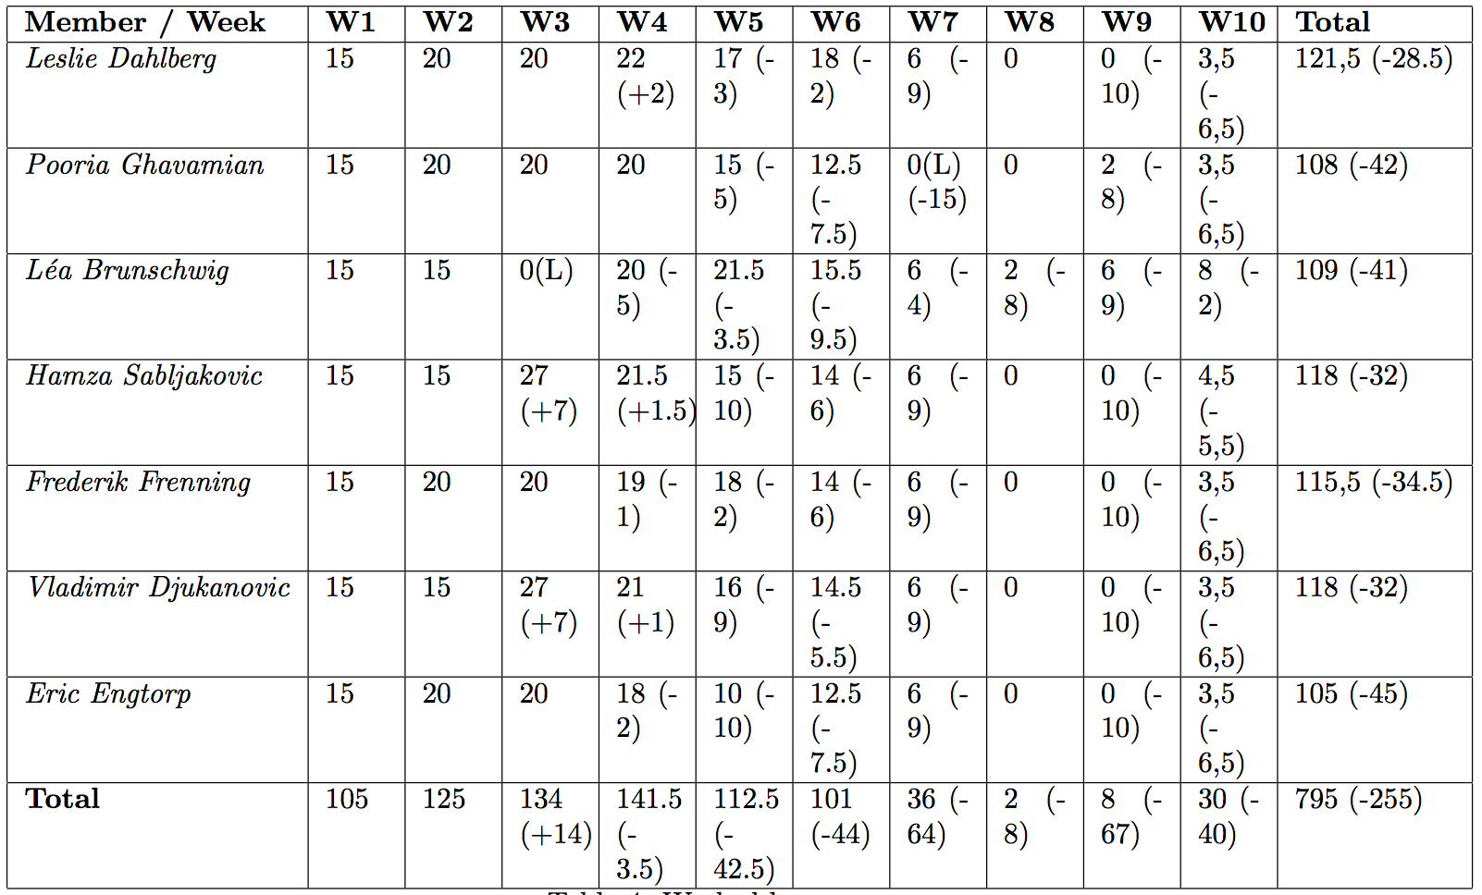
Worked hours

Slide 17
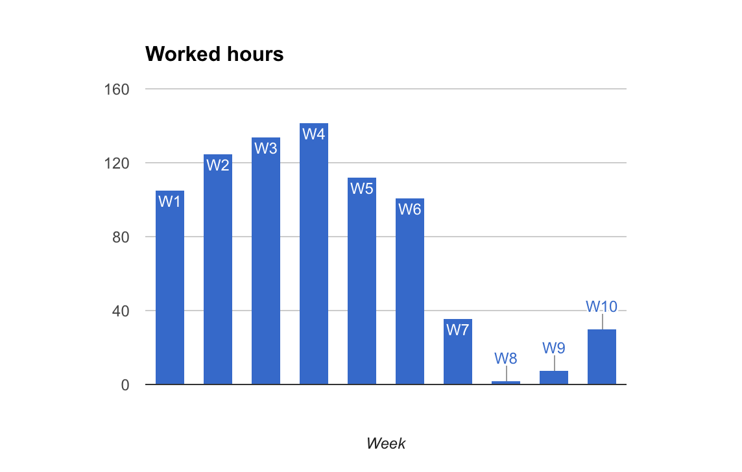

Slide 18
Activities
Android app
Web portal
Documentation and presentations

Slide 19
How did you manage changes along the way
Requirements
Communication

Slide 20
How did you divide and synchronize work
Based on skills
Slack
Trello
Google docs
Git

Slide 21
Did the routine change
Monday, 9 – 12 & 13:30 - X

Slide 22
Experiences

Slide 23



Positive Experiences
Backgrounds
Weekly meetings
Smaller groups
Tools
Building the product incrementally

Slide 24

Improvement Possibilities
Team Web, GUI, Backend
Add extra features
Workshop
Development Environment Issues

Slide 25
Questions?

